Slide 1
AFP Final Presentation
Group 20
Akram Khan
Audrey Zhou
Shubham Singh
Tathagat Saxena
Yujie Sun

Slide 2
AGENDA
Scope of Project
Literature Review
Data Description
Implementation
Analysis & Results
Research
Conclusion
Recommendations for Future Extension

Slide 3
Introduction
Literature
Review
Data
Description
Implement
Analysis
& Results
Research
Conclusion
Background
Applying data-science principles, quantitative modeling to make systematic top-down investment decisions of VC-backed private equity
The volatility of the asset price is associated with the nature of different funding round ( A pre-seed, Seed round, Series A, Series B, Series C, Mezzanine finance)
“I expect an x% up/down jump in valuation sometime in the next 2 years”
“What can we do for the volatility in the venture capital industry?”
“Any derivatives?”

Slide 4
Introduction
Literature
Review
Data
Description
Implement
Analysis
& Results
Research
Conclusion
Solution
Monitoring significant increase/decrease in the company’s valuation each funding round in which the price of the stock will multiple X times in potential. The best case scenario is a company with unicorn valuation going public.
Building an option pricing model to stair-step fashion price VC-backed private equity options.
Developing a modified jump diffusion option pricing model to account for the drastic price changes and unique implied volatility

Slide 5
Introduction
Literature
Review
Data
Description
Implement
Analysis
& Results
Research
Conclusion
Goal of the project
IPO analysis: to present a hedging strategy for a company prior to IPO
Additional income: to generate additional income through put writing a strategy and price an option on a forward contract
“At what stage in fund raising should we apply the strategy?”

Slide 6
Introduction
Literature
Review
Data
Description
Implement
Analysis
& Results
Research
Conclusion
Overview
  Financing (Pre/Post-Money)
  Selection Bias Removal
  Jump Diffusion Model

Slide 7
Introduction
Literature
Review
Data
Description
Implement
Analysis
& Results
Research
Conclusion
Financing (Pre/Post Money):
Government grants, accelerators/incubators, angel investors, and venture funds are crucial resources that can define a start-up’s growth trajectory
A start-up capital round typically ranges from $100,000 to $2 million, depending on the type of firm and geographic area (Famous examples - FB: 500K in 2004, AAPL: 250K in 1977, AMZN: 8M in 1997)
Pre-pricing usually refers to the value of a previous business - it's not inclusive - the last funding cycle mentioned.
Post-money valuation refers to the value of the start-up after receiving investments. Common factors influencing valuations: economic sector, technology, revenue, reputation, deal attractiveness.

Slide 8
Introduction
Literature
Review
Data
Description
Implement
Analysis
& Results
Research
Conclusion
Financing (Pre/Post Money):
Note that VC investing is risky business. Typically, you lose capital on 90-95% deals, get mediocre returns on 2-3% deals and (hopefully) hit a homerun 1% of the time.
As a general rule for estimating a start-up’s value, as current revenue projections are rarely proven to be accurate. Some commonly used methods are: First Chicago method, Venture Capital method, Comparative method, Book value method, Scorecard method, Risk Factor method.

Slide 9
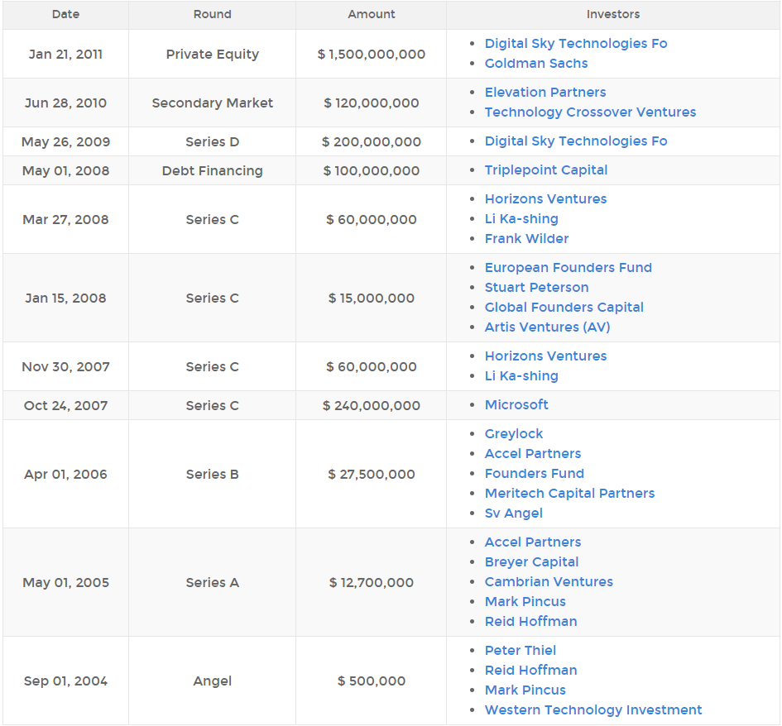
Introduction
Literature
Review
Data
Description
Implement
Analysis
& Results
Research
Conclusion
Financing:
Can you guess this company?

Slide 10
Introduction
Literature
Review
Data
Description
Implement
Analysis
& Results
Research
Conclusion
Selection Bias Removal
Selection Bias is bias introduced when proper randomization in the data is not achieved.
To understand the effects of selection, suppose that every project goes public when its value has grown by a factor of 10. Now, every measured return is exactly 1,000%, no matter what the underlying return distribution.
A mean return of 1,000% and a zero standard deviation is obviously a wildly biased estimate of the returns facing an investor!

Slide 11
Introduction
Literature
Review
Data
Description
Implement
Analysis
& Results
Research
Conclusion
Jump Diffusion Model
Attempting to help venture capital companies to optimize project exit decisions.
The expected discounted factor and a jump-diffusion process combine to assess the value of a start-up company, and determine the threshold of the exit timing of liquidation or convertibility for establishing the optimal disinvestment evaluation model for VC companies.
Startup Valuations, unlike public companies, do not have their valuations disclosed all the time. Moreover, their valuation jumps as and when they raise more money. This kind of price mechanics cannot be modeled using a simple GBM process, which is typically used for stock price mechanics. Thus, we chose a jump diffusion model along with a GBM process.

Slide 12
Introduction
Literature
Review
Data
Description
Implement
Analysis
& Results
Research
Conclusion
Data was provided by Equam Capital, including thousands of companies’ funding information in each round.
Variables:
  Date
  Number of Rounds
  Post-money Valuation
  Deal amount
  Total Capital Raised
  Dilutive Impact
  Type of Deals

Slide 13
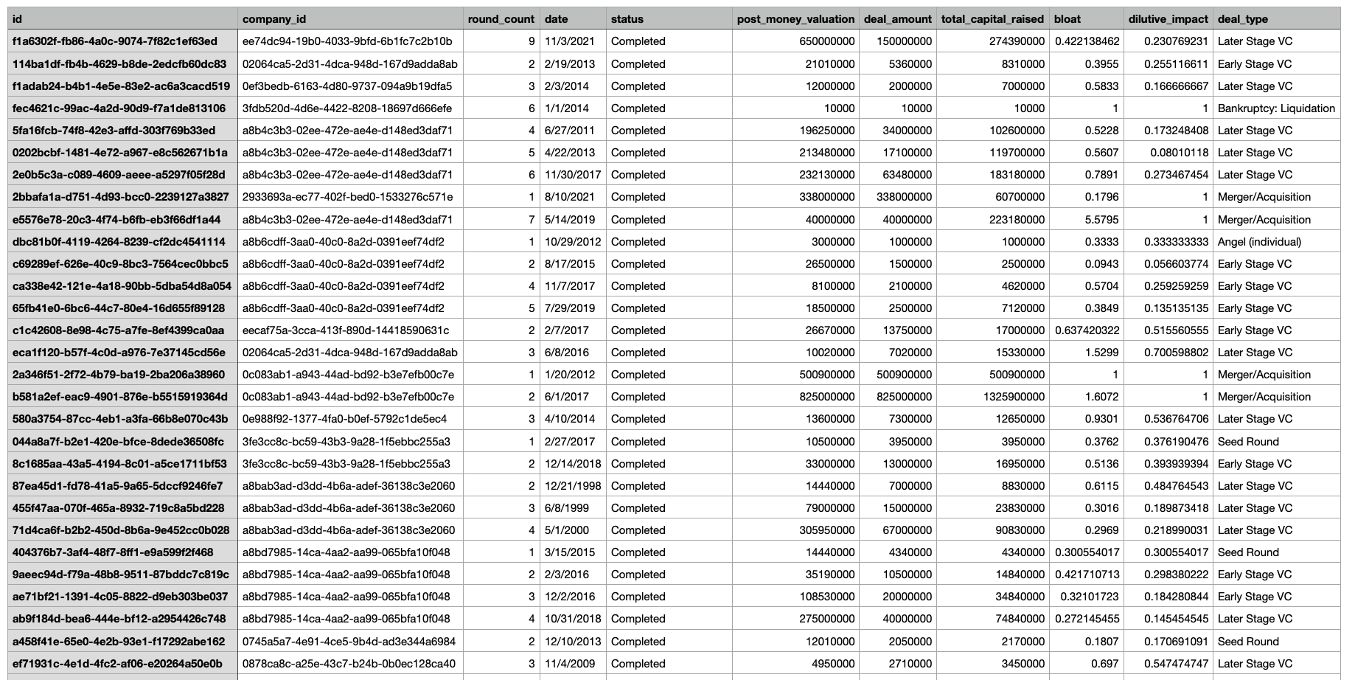
Introduction
Literature
Review
Data
Description
Implement
Analysis
& Results
Research
Conclusion

Slide 14
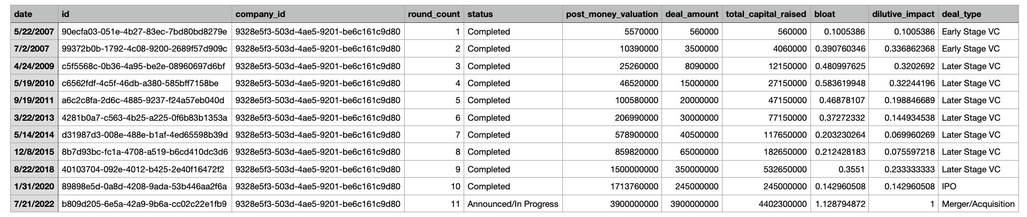
Introduction
Literature
Review
Data
Description
Implement
Analysis
& Results
Research
Conclusion
We first sort the data by companies, then chose the ones that have raised for more than 10 rounds as our sample.
Looped through 100 companies.

Slide 15
Introduction
Literature
Review
Data
Description
Implement
Analysis
& Results
Research
Conclusion
We used a jump-diffusion model along with geometric brownian motion to model the post-money valuation.
The equation we used was:
dV(t) = αV (t)dt + σ V(t)dW(t) − θV(t)dq(t).
We broke down the price movements into two parts:
  Jump from round to round.
  Amount raised in that particular round.
To model out the jump process we calibrated the λ parameter, i.e. the intensity of the jump. We calculated this using $ value of the jump divided by the time (in days) between the jump. We took the average of these values to estimate the parameter.

Slide 16
Introduction
Literature
Review
Data
Description
Implement
Analysis
& Results
Research
Conclusion
To estimate the mean and volatility of the price movements, we used the amount raised divide by the post-money valuation. We calculated the mean and standard deviation of these returns to estimate the parameters.
One of the roadblocks we overcame was the issue of selection bias, to mitigate that we ran an analysis on the dataset as per the paper, The risk and return of venture capital by John H.Cochrane. We noted the overall horizon of the dataset and noted the days with IPOs, Bankruptcies, Financing rounds, and no events. Then we came up with probabilities of these aforementioned events. Following that, we ran the analysis on individual companies to find their individual probabilities. We incorporated these probabilities in the estimation of σ and μ.

Slide 17
Introduction
Literature
Review
Data
Description
Implement
Analysis
& Results
Research
Conclusion
After the estimation of the key parameters, we simulated the prices and priced an option on the company using monte-carlo simulation technique.
To estimate the option strike, we used the liquidation value as mentioned in the paper; Applying jump-diffusion processes to liquidate and convert venture capital by Tyrone T. Lin, Chuan-Chuan Ko, Chia-Wen Chang . The liquidation value, for the above equation, turned out to be L = aV^{u} where a= (1/u)*(V ) ^{1−u}
We solved for u by solving the quadratic + exponential equation (below) approximately using taylor’s expansion.
    0.5 * σ² * u² + (α − 0.5* σ² ) * u − (λ + rf ) + λ*θ^{u} = 0.
We assumed the value of theta (influence of the poisson process on each jump) to be 0.5, but this can be varied as per user.

Slide 18
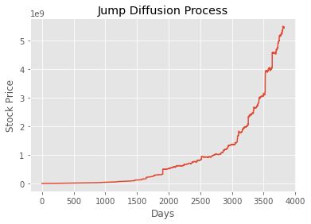
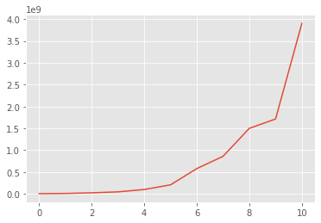
Introduction
Literature
Review
Data
Description
Implement
Analysis
& Results
Research
Conclusion
The model predicted the price well. Below are the actual price movement vs. the simulated price graphs.
Model predicted Price
Actual Price

Slide 19
Introduction
Literature
Review
Data
Description
Implement
Analysis
& Results
Research
Conclusion
After running the analysis on 100 companies with 10+ rounds, we obtained the following results for some specific cases
We have tabulated here the results for 4 average volatility cases and 5 high volatility cases. The ratio of option price to valuation seems to be directly related to the volatility and the return, however not linearly.
Index | post_money_valuation | volatility | mean_return | option_price
1 | $718,500,000.00 | 16% | 23% | $24,678,646.73
2 | $280,000,000.00 | 23% | 7% | $67,772,569.53
3 | $1,040,280,000.00 | 25% | 25% | $99,976,948.92
4 | $400,000,000.00 | 25% | 23% | $62,592,269.27
5 | $3,300,000,000.00 | 104% | 131% | $148,734,343.19
6 | $3,952,690,000.00 | 112% | 120% | $692,438,385.00
7 | $2,650,000,000.00 | 115% | 148% | $428,477,896.23
8 | $1,077,110,000.00 | 117% | 76% | $183,401,590.33
9 | $40,000,000,000.00 | 124% | 177% | $271,148,490.58

Slide 20
Attempted enhancements to try and increase prediction accuracy
Introduction
Literature
Review
Data
Description
Implement
Analysis
& Results
Research
Conclusion
Tried using:
Light Gradient Boosting Machine Model for Finance
Neural Network Model for Finance
Realized need more company specific model. Therefore decided with Jump Diffusion model.

Slide 21
Introduction
Literature
Review
Data
Description
Implement
Analysis
& Results
Research
Conclusion
The model seems to do a fair job in estimating the price of the option right before an IPO. Given the randomness of the occurrences of events (i.e., raising a round, IPO, etc.), the selection bias removal approach was key is the estimation of the volatility and mean of the price movements of these companies.
Post the selection bias removal exercise, we were able to reduce the volatility and mean significantly which resulted in a fair and a more conservative option price.
The Liquidation value method in calculating the strike price also is a key part of the model. The overall idea being that the owner of the option would be interested in holding the option only if the company is able to remain significant.

Slide 22
Recommendations for Future Extension
While the Liquidation Value method fits well in our analysis and gives fair results, the strike price produced is more conservative than market expected values. Therefore, we believe this approach could be modified further.
Another scope of improvement is using a more elaborate approach towards selection bias removal since it is the the most significant output driver in the model.

Slide 23
Thank You!
Questions?

